Slide 1
Tech Requirements
Your laptop.
Download materials from: https://github.com/fmt-js
A text editor, recommend Sublime Text 3 (It's free and available for Mac/PC/Linux -http://www.sublimetext.com/3
OR - Download Visual Studio Code. https://github.com/fmt-js
d
Notes:
Tech Requirements: • Your laptop. (Note: a netbook or tablet is NOT a substitute!) • A modern browser such as Chrome or Firefox installed. • A text editor. We recommend Sublime Text 3 (It's free and available for Mac/PC/Linux - http://www.sublimetext.com/3).

Slide 2
Intro to JavaScript
Denise Nguyen
Consultant, FMT Consultant

Slide 3

dkitty
CRM Consultant
Everyone calls me kittie, I love cats and made a lot cats noises in high school. No I have never had a cat before.
I haven’t been at FMT for even a year and I love D365 CRM so much!!!

Slide 4
Agenda
Overview of HTML, CSS, and JS
What you can do with JavaScript
Script Tags and Files
Statements and Comments
Variables, naming variables, and variable values
Arithmetic Operators
Strings and Concatenate

Slide 5

What is JavaScript?
JavaScript is not Java

Slide 6
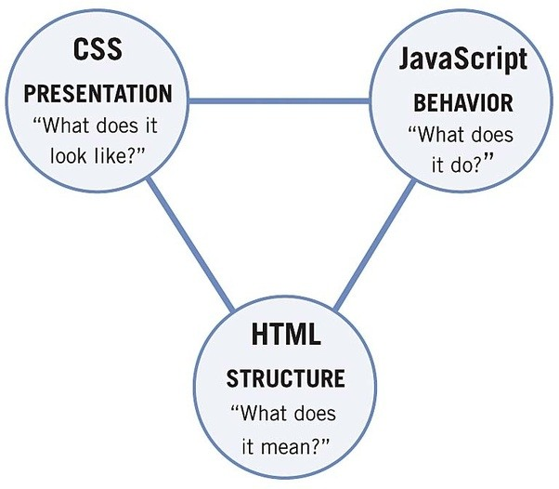
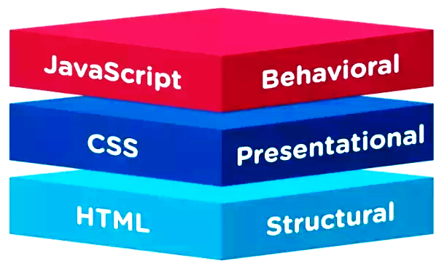
JavaScript works with HTML & CSS
Notes:
HTML, CSS, and JS are web programming languages. They work together to create what you wuld see when you are a website.
HTML is your document markup language, perhaps you have a blogging website, HTML is all the titles to the blog post and the content, maybe you have images as well.
CSS is how will your document look how you will style it.
Now JavaScript tells your document how to respond or behave.

Slide 7
What is JavaScript?
A client-side processing language.
A browser reads the code and runs it directly.
Interfaces with HTML & CSS.
Lets you build dynamic web pages that respond to input from users.

Slide 8
What can JavaScript do?
Let’s find out!

Slide 9
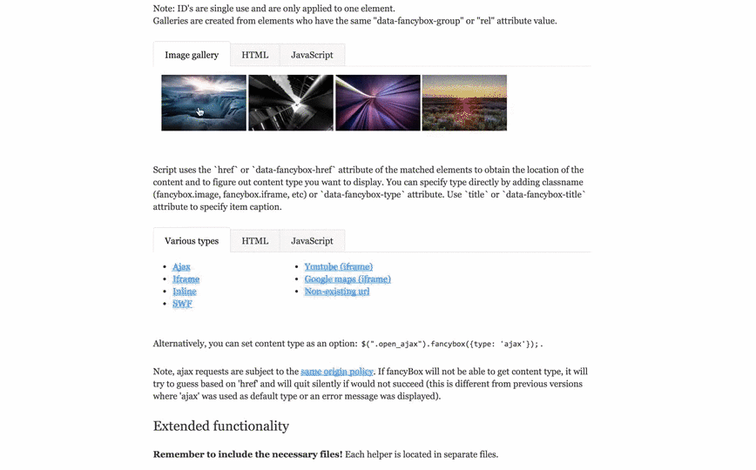
Image Lightboxes

Slide 10
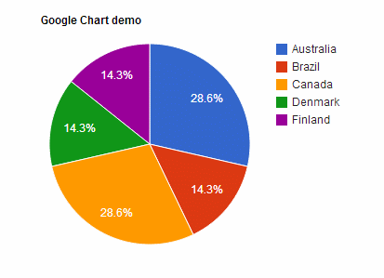
Google Charts API

Slide 11

Keep track of users with Cookies or storing data with local storage.

Slide 12

Interactive elements like tabs, sliders, etc.

Slide 13
Script Tags
You can mix JavaScript and HTML. The script tag tells your browser the stuff inside is code, not content.
<script> CODE GOES HERE </script>

Slide 14
JavaScript Files
Just like CSS, you can split a long block of JavaScript into its own file.
<script src="path/to/file.js"></script>

Slide 15
Let’s get setup to start coding (:

Slide 16
Let’s Develop It
Make a folder called FMT-JS
Inside, make a new page called index.html
Write your code
<!DOCTYPE html> <html> <head> <title>Test Page</title> </head> <body> <p>This is my awesome JavaScript Code.</p> <script> alert('Hello World!'); console.log('Secret message'); </script> </body> </html>
Notes:
<script>
document.getElementById('meow').innerHTML += 'Hello there';
</script>

Slide 17
Let’s Develop It
Make a folder called FMT-JS
Inside, make a new page called index.html
Write your code
<script> alert('Hello World!'); console.log('Secret message'); </script>

Slide 18

Computers need simple, clear instructions
Computers are great at processing. They are bad at understanding.
When you write a program, you must break down every step into simple pieces.

Slide 19
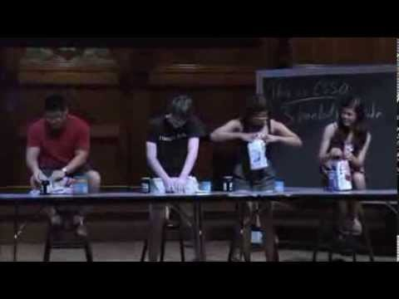
Example: Make a Sandwich
Notes:
Source: Harvard Students Making Sandwich: CS 50 Algorithm Intro
https://www.youtube.com/watch?time_continue=172&v=XWe4iohhmIw

Slide 20
OVERVIEW OF JAVASCRIPT

Slide 21
How does JavaScript work?
You visit a website with JavaScript code on it.
Your browser (e.g., Chrome) reads the code line-by-line.
The browser runs each line of code as it reads it.
Based on these instructions, the browser performs calculations and changes the HTML and CSS on the page.
If the browser finds code it doesn't understand, it stops running and creates an error message.

Slide 22
Let’s Develop It
Open the console.
In Chrome, use the keyboard shortcut:
Mac: Command + Option + J
Windows: Control + Shift + J
Open your practice page.
Do you see anything in the console?
Try typing in 2 + 2 and hitting enter.

Slide 23
Statements
Each instruction in JS is a "statement", like:
console.log('Hello World!'); console.log('I am glad to meet you'); console.log('I am fuzzy');

Slide 24
Comments
You can leave comments in your code—notes that people can read but computers will ignore.
//MEOW THESE ARE CONSOLE LOGS
console.log('Hello World!'); console.log('I am glad to meet you'); console.log('I am fuzzy');

Slide 25
Getting results onto your screen
Open a popup box.
alert('Hello World!');
Display a message in your console.
console.log('Hello World!');
Add something to the page.
document.write('Hello World!');

Slide 26
LET’S CODE TOGETHER!

Slide 27
Let’s Develop It
Open index.html.
Add a comment to the code.
Try different ways of printing a message.
Create a new file called mycode.js.
Move your code to this file and link it to your page.
<!DOCTYPE html> <html> <head> <title>Test Page</title> </head> <body> <p>This is my awesome JavaScript Code.</p> <script> alert('Hello World!'); console.log('Secret message'); </script> </body> </html>
Notes:
<script src="js/mycode.js"></script>

Slide 28
Variables
Just like 'x' in algebra, a variable is a named container for a value that can change.
Declaring a Variable
To declare (create) a variable, just type the word var and the variable name.
var numberOfKittens;
It is a good idea to give your variable a starting value. This is called initializing the variable.
var numberOfKittens = 5;

Slide 29
Variable Values
When you first create a variable, it does not have a value (it is undefined).
You can set a value for a variable.
Variables can hold different types of data.
The value of a variable can change over time.

Slide 30
Naming Variable
The variable name is case-sensitive.
A new variable should have a unique name.
Variable names need to start with a letter,$, or _.
Avoid reserved words.
Choose clarity and meaning for humans to read later.

Slide 31
Using Variables
Once you have created a variable, you can use it in your code. Just type the name of the variable.
Using a Variable
To declare (create) a variable, just type the word var and the variable name.
var numberOfKittens = 5; console.log(numberOfKittens);

Slide 32
Let’s Develop It
In your JavaScript file, create a variable and give it a valid name and value. Then, display the value.
You can run it in mycode.js.
<!DOCTYPE html> <html> <head> <title>Test Page</title>
</head> <body> <p>This is my awesome JavaScript Code.</p>
<!-- LINK FOR JS FILE -->
<script src="mycode.js"></script> </body> </html>

Slide 33
Data Types
string string of characters
var userName = 'Jane Lane';
number integer or floating point
var myAge = 30;
boolean true or false
var myAge = true;
null an explicitly empty value
var goodPickupLines = null;

Slide 34
Arithmetic Operators
Once you have numbers, you can do math with them!
var numberOfKittens = 5; var numberOfPuppies = 4; var numberOfAnimals = numberOfKittens + numberOfPuppies;

Slide 35
Arithmetic Operators
Example | Name | Result
-a | Negation | Opposite of a
a+b | Addition | Sum of a and b
a-b | Subtraction | Difference of a and b.
a*b | Multiplication | Product of a and b.
a/b | Division | Quotient of a and b.
a%b | Modulus | Remainder of a divided by b.

Slide 36
Let’s Develop It
Create two variables and try some arithmetic operators. Don't forget to display your results!
You can run it in mycode.js.
<!DOCTYPE html> <html> <head> <title>Test Page</title>
<!-- LINK FOR JS FILE -->
<script src="mycode.js"></script> </head> <body> <p>This is my awesome JavaScript Code.</p> </body> </html>

Slide 37
Strings
Variables can be strings (groups of characters). You put your string in single or double quotes.
var kittensName = 'Fluffy';
If you want to use a quote in your string, you'll need to escape it with a backslash.
console.log('I\'d like to use an apostrophe');

Slide 38
String Operators
You can put strings together with a +, the concatenation operator.
var kittensName = 'Fluffy '; var fullName = kittensName + 'McDougle'; console.log(fullName); // Outputs 'Fluffy McDougle'

Slide 39
String Operators
You can also use += to add things to the end of a string.
var kittensName = 'Admiral '; kittensName += 'Snuggles'; console.log(kittensName); // Outputs 'Admiral Snuggles'

Slide 40

ConCATenate

Slide 41
Concatenate
+ operator. The + operator does string concatenation as soon as one of its operands is a string. Then the other operand is converted to string.
Joining an array of strings. Collect the strings to be concatenated in an array and join it afterwards.
var kittensName = 'Admiral '; kittensName += 'Snuggles'; console.log(kittensName); // Outputs 'Admiral Snuggles'

Slide 42
Let’s Develop It
Create two variables, a first name and a last name, and then put them together to make a full name. Don't forget to display your results!
You can use concatenation to mix strings and numbers. When you do this, JavaScript will treat the number like a string.
You can run it in mycode.js.
var numberOfFruit = 6; var typeOfFruit = 'bananas'; var allTheFruit = 'I have ' + numberOfFruit + ' ' + typeOfFruit + '!'; console.log(allTheFruit);

Slide 43
More Practice
Create a program to calculate the tip at a restaurant. It should:
Have variables for the bill pre-tip and the tip percentage.
Calculate the total bill.
Output a sentence like "Your total bill, with tip, is $14.75".
Bonus: Use toFixed() to round the bill total to 2 decimals.

Slide 44
Thank You!
Denise Nguyen
dnguyen@fmtconsultants.com

